Slide 1
ElectViz - Election Data Visualization for Media
Presented by :-
Y. Radha sri
Under the supervision of :-
Mrs. Nithyasri S J

Slide 2
Introduction
ElectViz is an interactive data visualization project designed to analyze, interpret, and present election data in a clear and engaging way. Developed using Power BI, this project transforms large-scale election datasets into intuitive dashboards that help media organizations, analysts, and the public gain meaningful insights into voting patterns, party performance, and regional election dynamics.
The project demonstrates how data analytics and visualization can enhance political reporting by offering fact-based, data-driven stories. By simplifying complex datasets into visual narratives, ElectViz empowers users to make informed interpretations of election outcomes.

Slide 3
System design and Workflow
Data Ingestion: Extracted raw election data from CSV/Excel feeds and historical JSON repositories.
Data Cleaning (ETL): Handled in Power Query to remove nulls, standardize constituency names, and merge datasets.
Data Modeling: Developed DAX measures for "Vote Share" and "Party Swings".
Visualization Layer: Created interactive Choropleth Maps for real-time reporting.
Final Output: A scalable, high-readability dashboard that transforms raw electoral numbers into actionable public information.

Slide 4
Future enhancements
Predictive Analytics: Integrating Machine Learning (ML) models to forecast "Probable Winners" and seat tallies based on early trends and historical voter-shift data.
Sentiment Analysis: Adding a social media feed component that uses NLP to visualize public sentiment and bias in real-time alongside official results.
Mobile-Optimized Layouts: Developing a native mobile view with push notification alerts for "VIP Seat" changes, ensuring accessibility for journalists on the field.

Slide 5
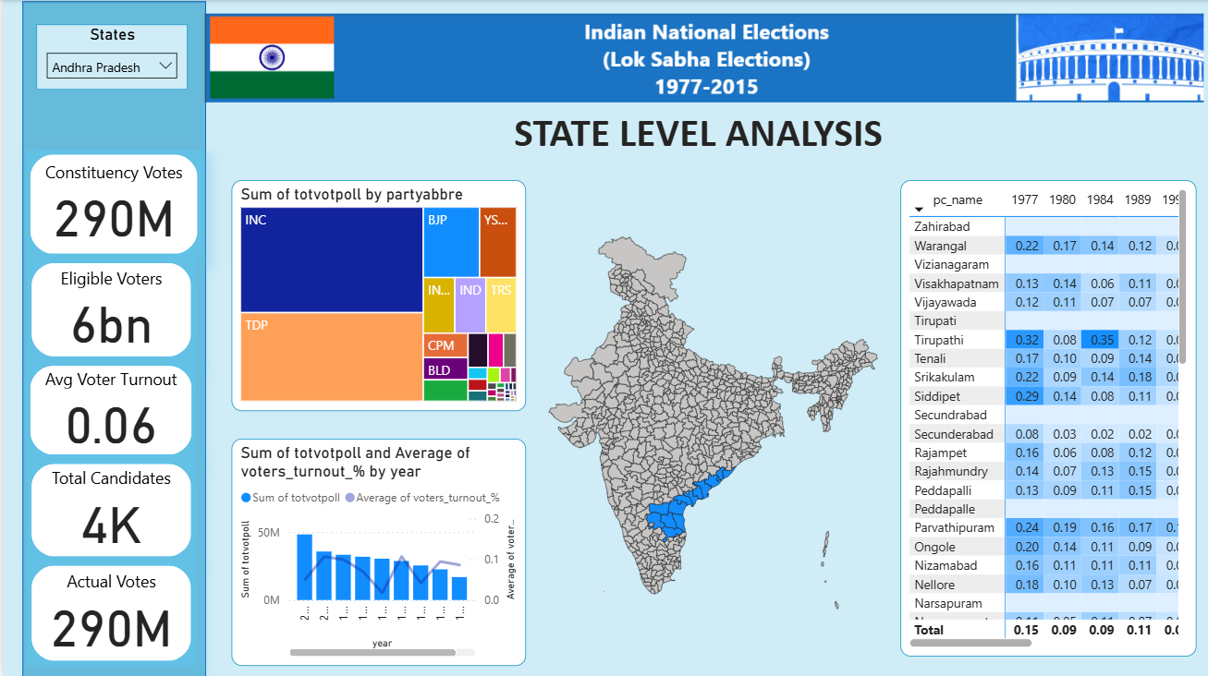
Proof of work

Slide 6
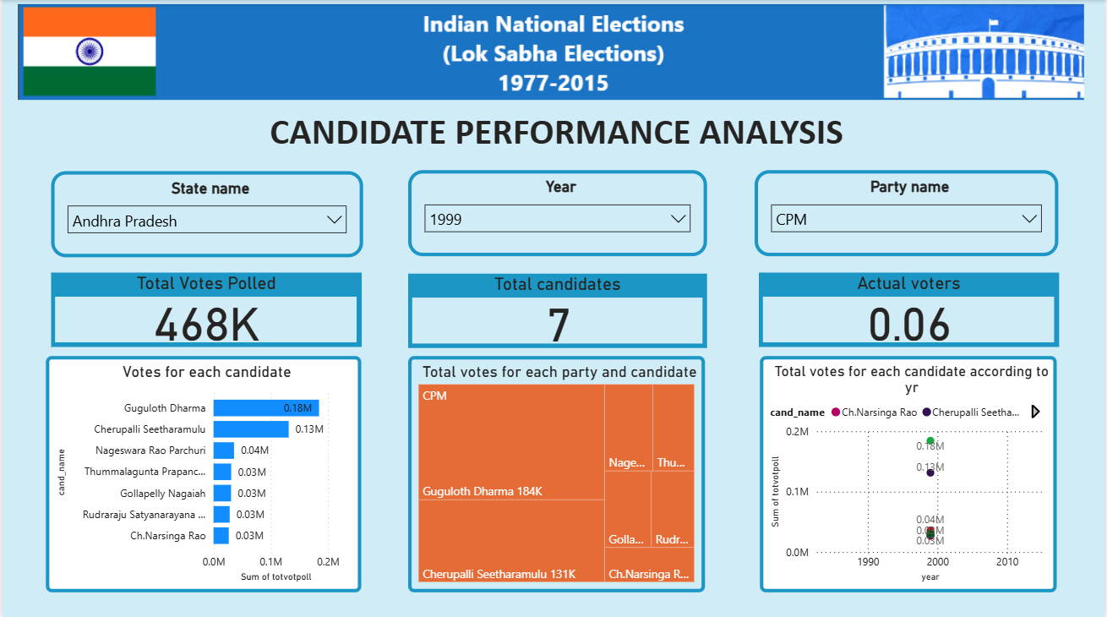

Slide 7
Conclusion
ElectViz successfully bridges the gap between raw electoral data and actionable public information by providing a centralized, automated visualization framework. By transforming complex datasets into intuitive, interactive dashboards featuring choropleth maps and swing-analysis charts, the platform overcomes the high latency and manual errors inherent in traditional reporting. The implementation of a robust data pipeline ensures that real-time insights enables newsrooms to identify critical "voter-shift" and "anti-incumbency" patterns instantly. Ultimately, this project offers a scalable, low-latency solution that enhances democratic transparency and provides broadcast-ready graphical insights for the digital age.

Slide 8
THANK YOU

